Slide 1
Sonnets by women made by : Amir Maya Negar

Slide 2
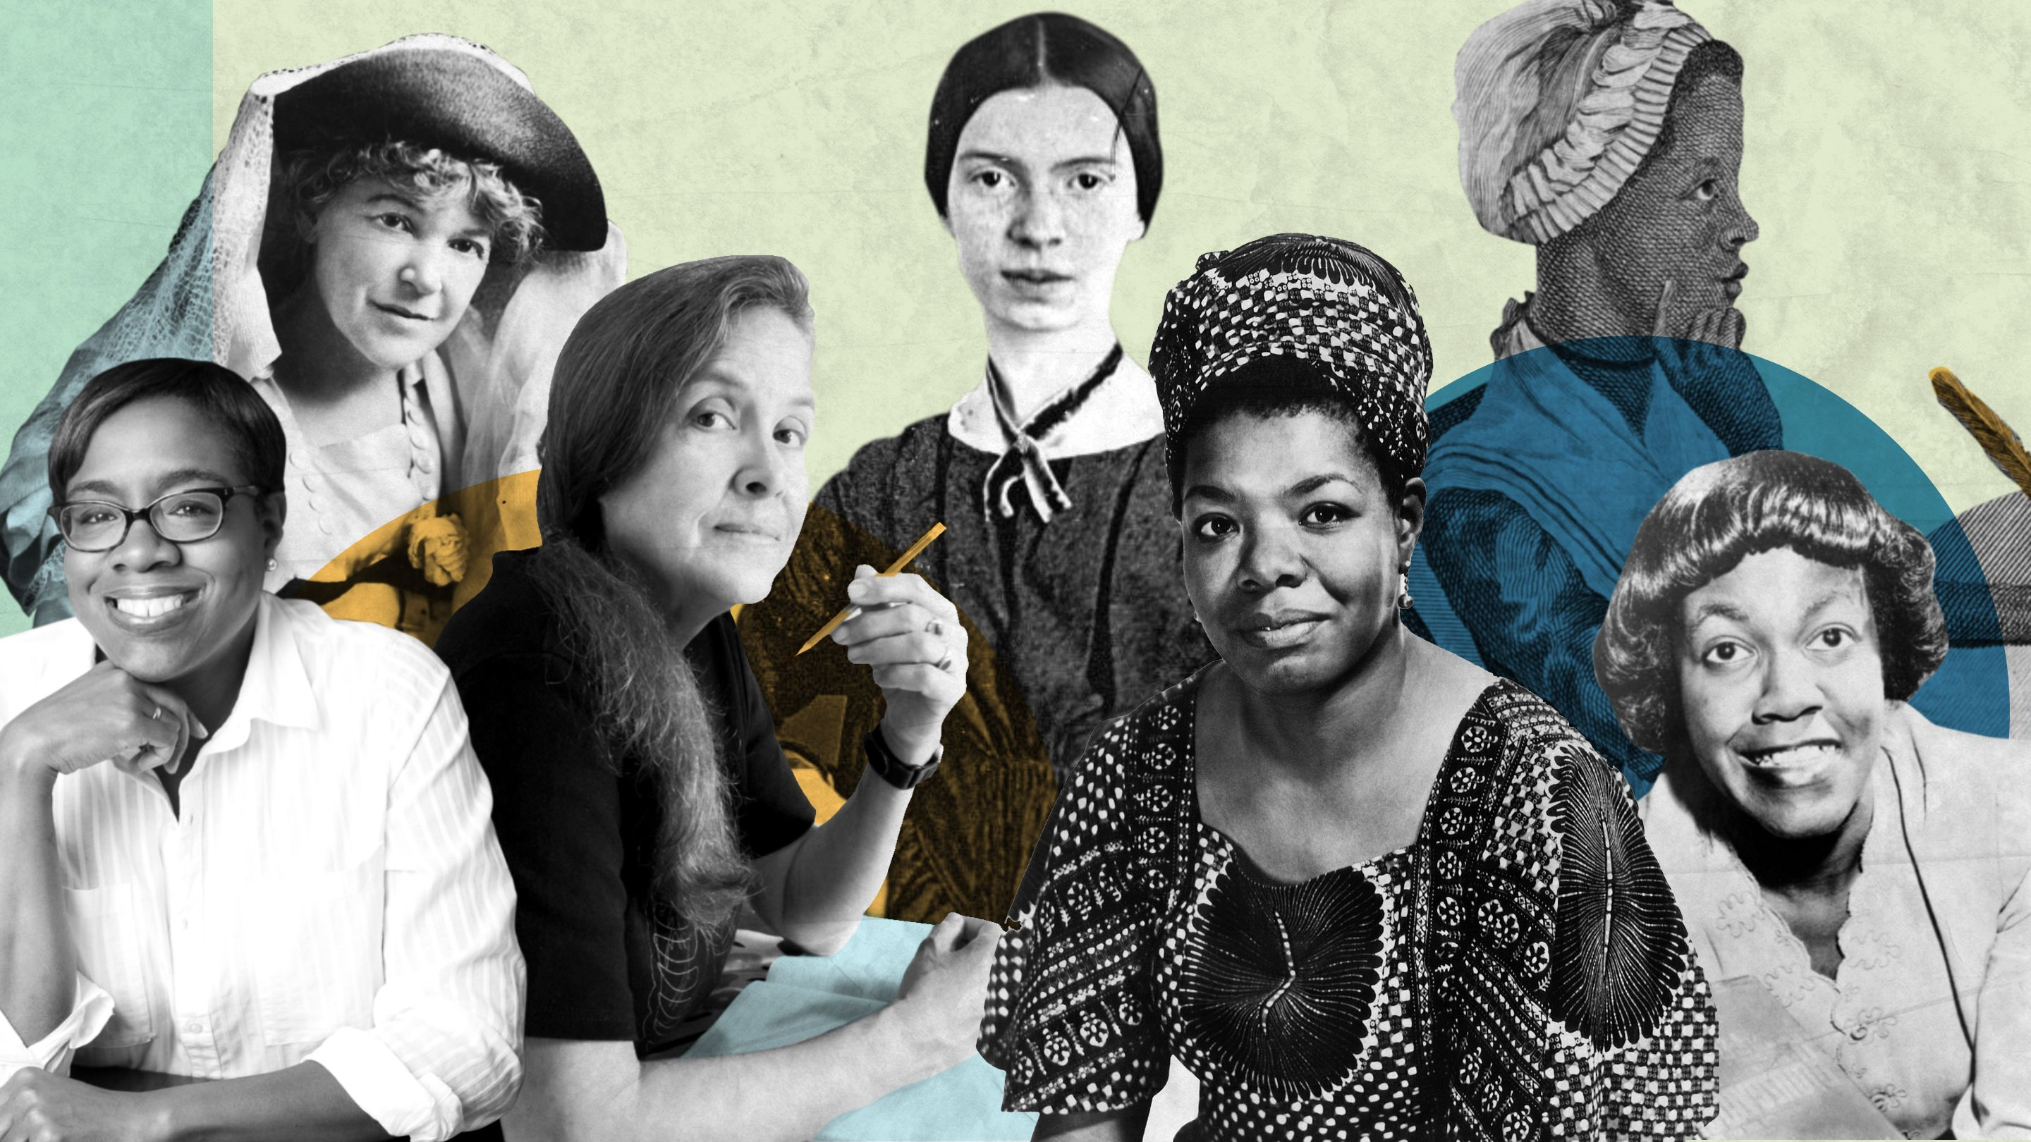

Slide 3
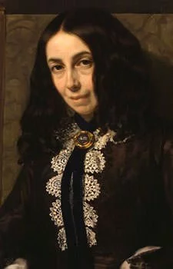

Role of women in literature
the sonnet became popular in many different countries during the Renaissance. This lesson includes sonnets by two extraordinary women of the Renaissance, the French writer Louise Labé and the Mexican writer Sor Juana Inés de la Cruz. In order to write, both women had to break down barriers created by prejudice and social custom, for women were not expected to become authors.
Elizabeth Barrett Browning

Slide 4
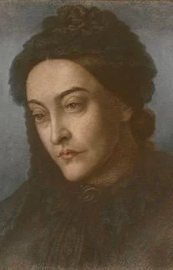
Female Writers Have Made A Great Impact On Literature Throughout History Female writers have made a great impact on literature throughout history. Whether it be in poetry, short story, or novels female writers have introduced new forms of writing throughout the ages.
Christina Rossetti

Slide 5
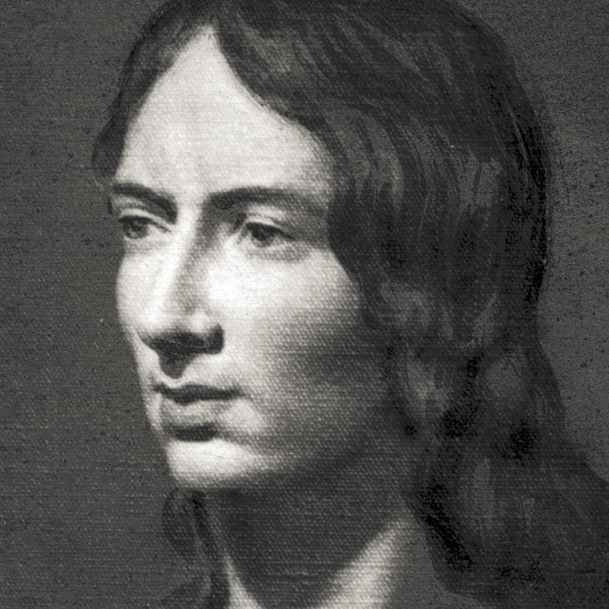
Many female writers never received recognition while they were still living, instead the recognition they deserved mostly came after death. Many female writers had hard lives that lead them to becoming the writers that they were. Most suffered some type of hardship be it a poor childhood, death, or heartache, they all had their own back stories. Two of the greatest female writers in history were Jane Austen and Emily Brontë.
Emily Brontë

Slide 6
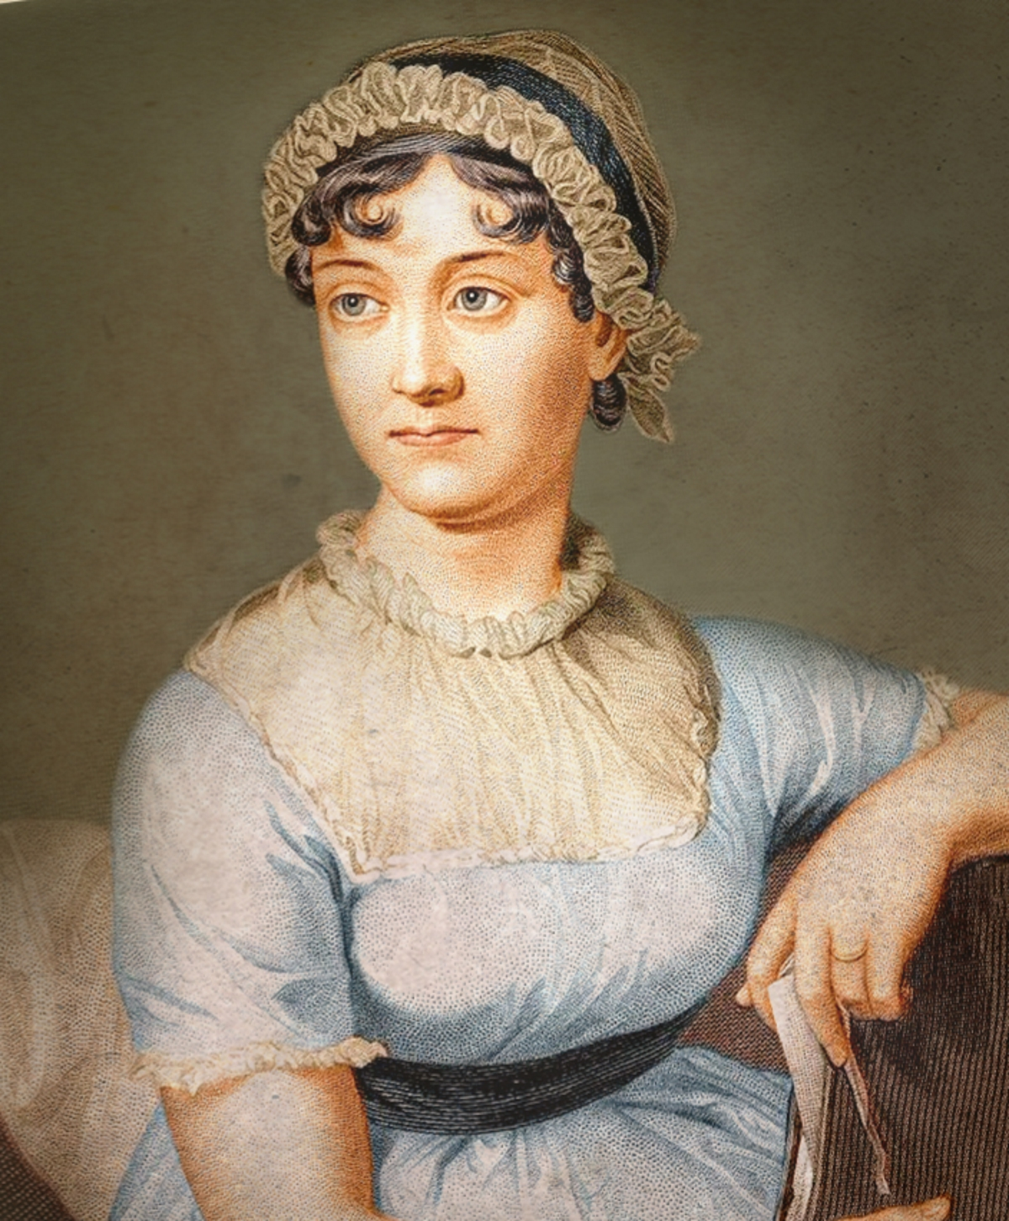
Although they are both well-known female writers, their personal histories influenced there themes and modes of writing very differently.
Jane Austen

Slide 7
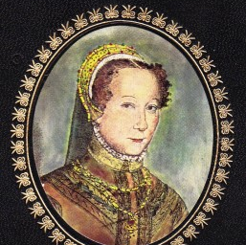
Courtly Education Louise Labé (lä-bā') was born in Lyon, France. Her father was a prosper- ous ropemaker who could neither read nor write, yet he prepared his daughter for entrance into polite society by giving her an education. She studied Latin, Italian, music, and horsemanship, becoming an accomplished lute player, singer, and rider. In about 1543, she mar- ried a much older widower who successful ropemaker like her father. Before her husband's death in 1560, Labé fell in love with the poet Olivier de Magny, the subject of many of her love poems.

Slide 8
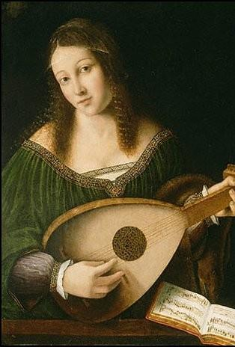
Literary Success In 1555, Labé published her only book, Works, which included 24 love sonnets and a prose "debate" between Folly and Love. In the book's preface, Labé called on women to set aside their chores and frivolous pastimes to pursue literature and other cultural activities.

Slide 9
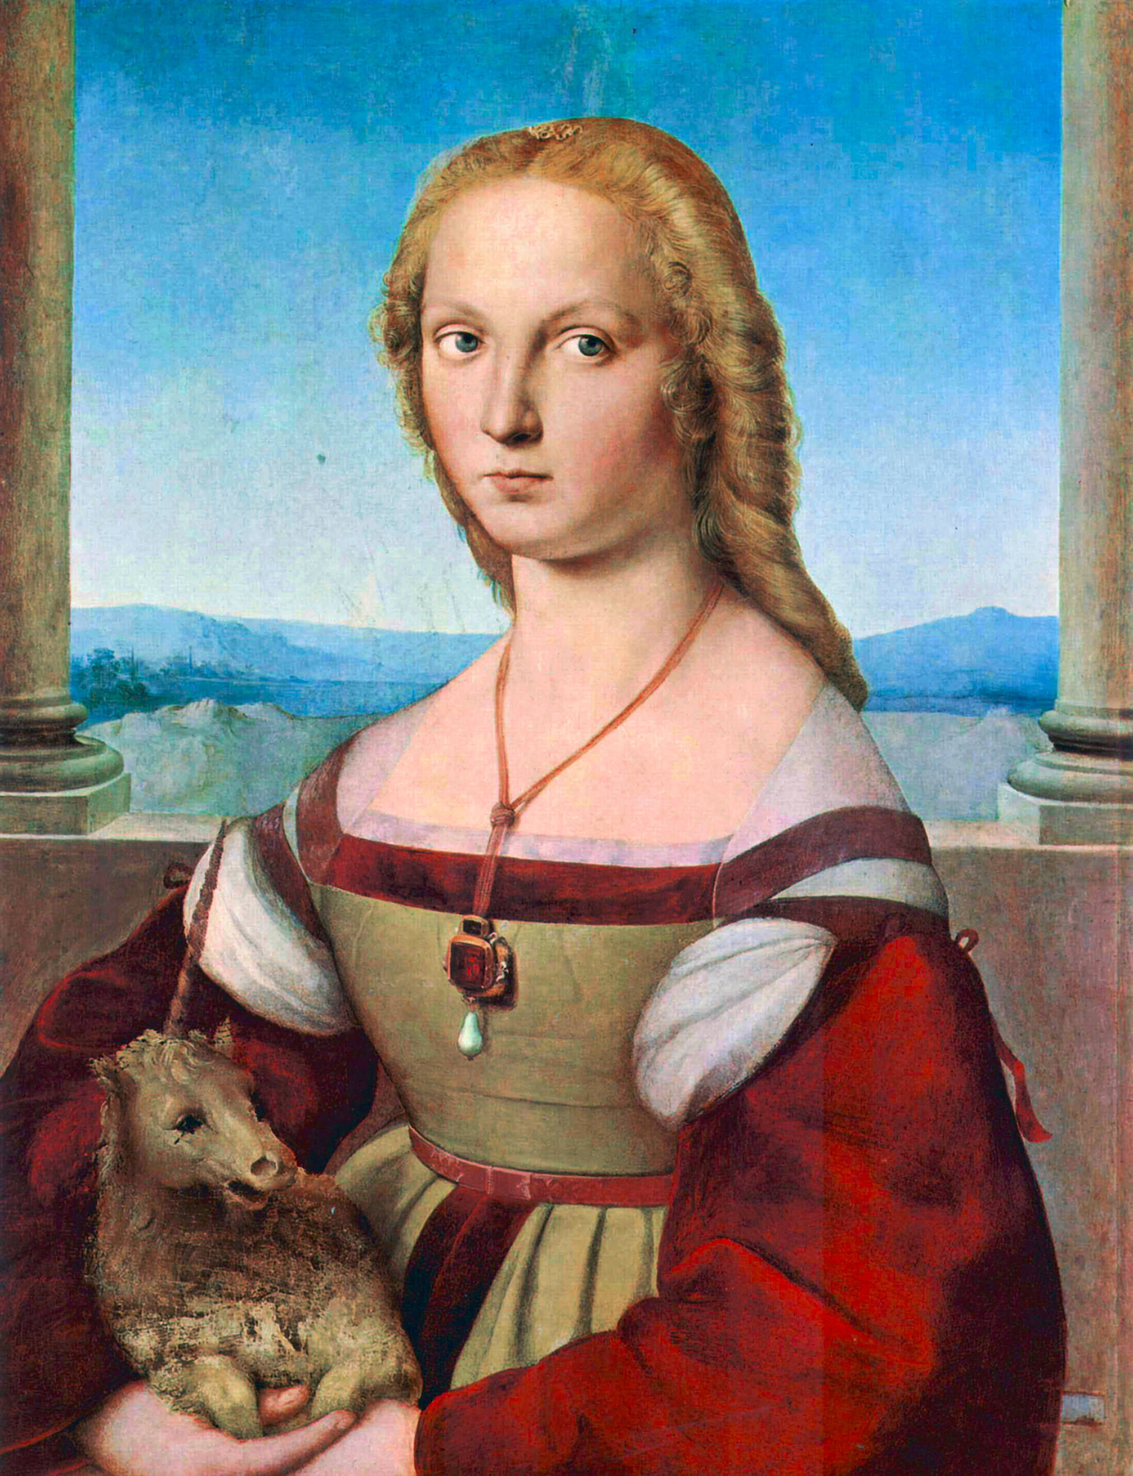
Sonnet 23 Louise Labé Translated by Willis Barnstone

Slide 10
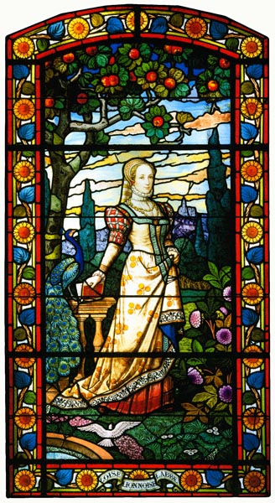
What good is it to me if long ago
you eloquently praised my golden hair,
compared my eyes and beauty to the flare
of two suns where, you say, love bent the bow,
sending the darts that needled you with grief?
Where are your tears that faded in the ground?
Your death? by which your constant love is bound
in oaths and honor now beyond belief?
Your brutal goal was to make me a slave
beneath the ruse of being served by you.
Pardon me, friend, and for once hear me through:
I am outraged with anger and I rave.
Yet I am sure, wherever your have gone
You're my martyrdom is hard as my black dawn.

Slide 11
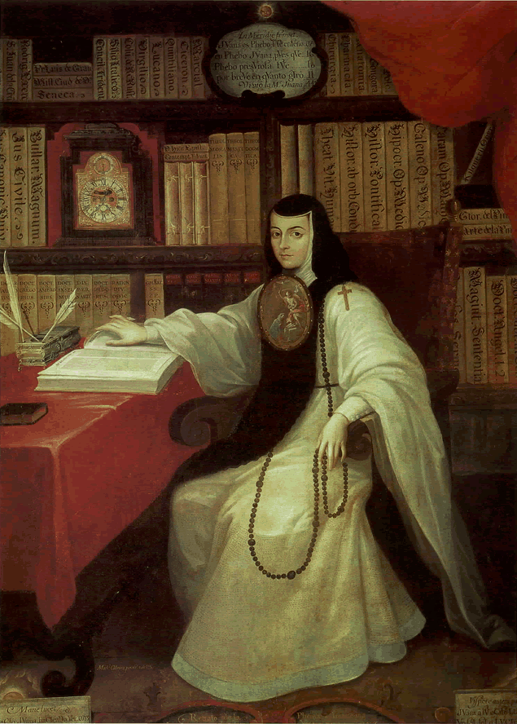
Noble Beginnings
Juana Inés de la Cruz (hwa'na ē-něs' dě la kro0S') was born into a noble Mexican family. By the time she was 6 years old, she was able to read every book in her grandfather's library. At about the age of 15, she became a lady in waiting to the marquise of Mancera, the wife of Mexico's governor. For several years, she lived in the palace, where she wrote, studied, and served the marquise

Slide 12
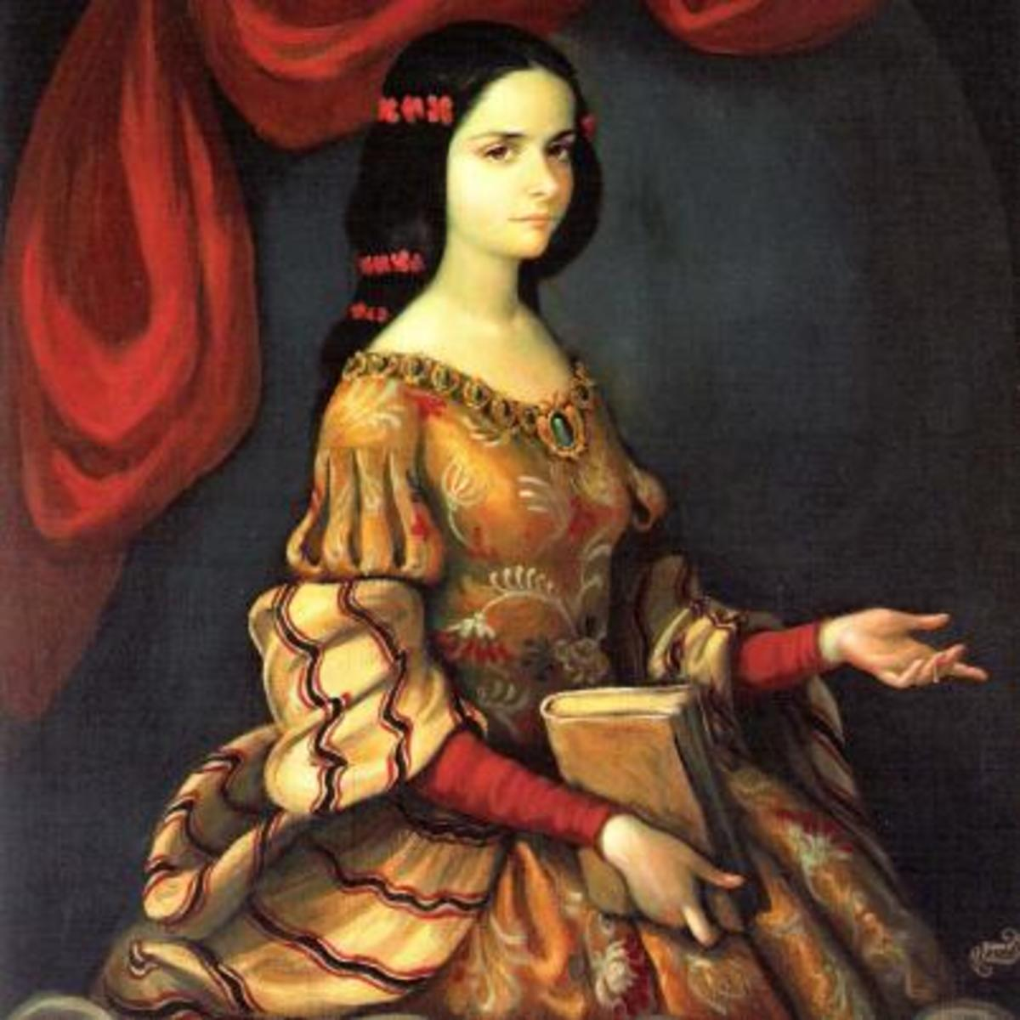
A Religious Calling When she was about 19, Juana Inés decided to become a nun. This decision gave her an opportunity to pursue her writing and education. While living in a convent, she accumulated thousands of books, acquired scientific instruments, and corresponded with friends in Spain and the United States. Because she was not burdened with household responsibilities, she had time to write songs, poetry, and plays. However, in 1690, Sor Juana faced a crisis when she published a highly critical letter about the ideas of a well-known Jesuit priest. Persecuted by archbishop of Mexico as a result of writing this letter, she was forced to stop writing altogether and had to turn over her books and scientific equipment to charity. After Sor Juana died in an epidemic in 1695, the archbishop's representatives confiscated her remaining possessions-except one carefully hidden poem.

Slide 13
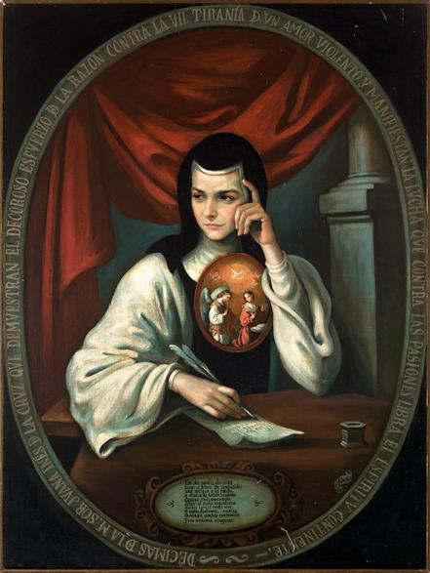
Stay, shadow of contentment too short-lived,
illusion of enchantment I most prize,
fair image for whom happily I die,
sweet fiction for whom painfully I live.
If to your charms attracted I submit,
obedient, like steel to magnet fly,
by what logic do you flatter and entice,
only to flee, a taunting fugitive?
Tis no triumph that you so smugly boast
that I fell victim to your tyranny;
though from encircling bonds that held you fast
your elusive form too readily slipped free,
and though to my arms you are forever lost,
you are a prisoner in my fantasy.

Slide 14
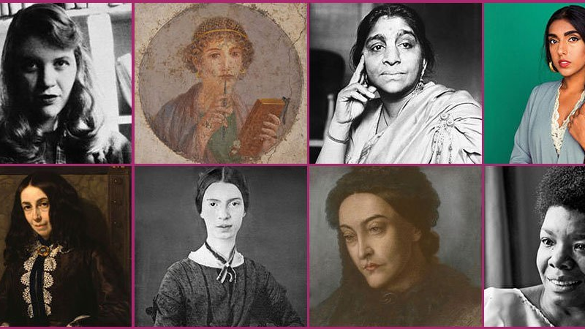
Thanks for your attention

